Slide 1
Software Update
Abhimanyu
08-13-2020

Slide 2
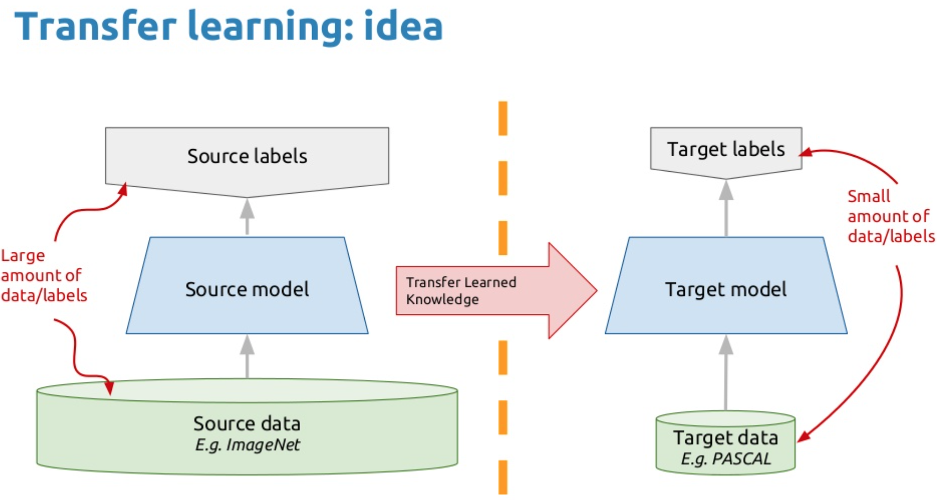
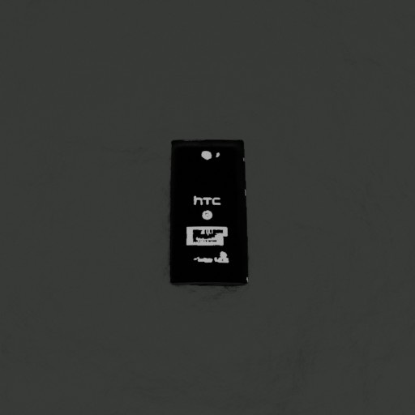
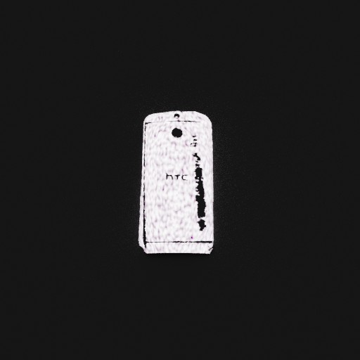
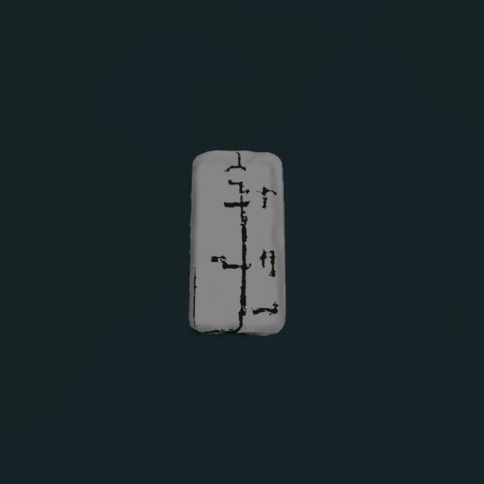
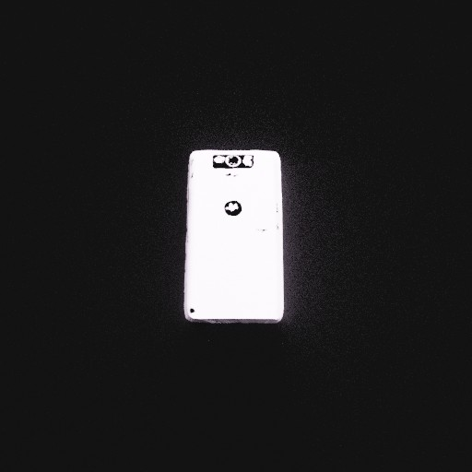
Method 1 tried this week:
Transfer learning of classification network based on Inceptionv3 model.
Dataset:
Synthetic data generated using domain randomization.

Slide 3
Accuracy results
Exp | Size | Preprocessing | Best accuracy(%)
1 | 280x280 | Resize | 52.2
2 | 640x640 | Resize | 79.02
3 | 640x640 | Resize,Data Aug. | 65.6
4 | 640x640 | Resize, Grayscale | 69.6
5 | 800x800 | Resize | 42.4

Slide 4
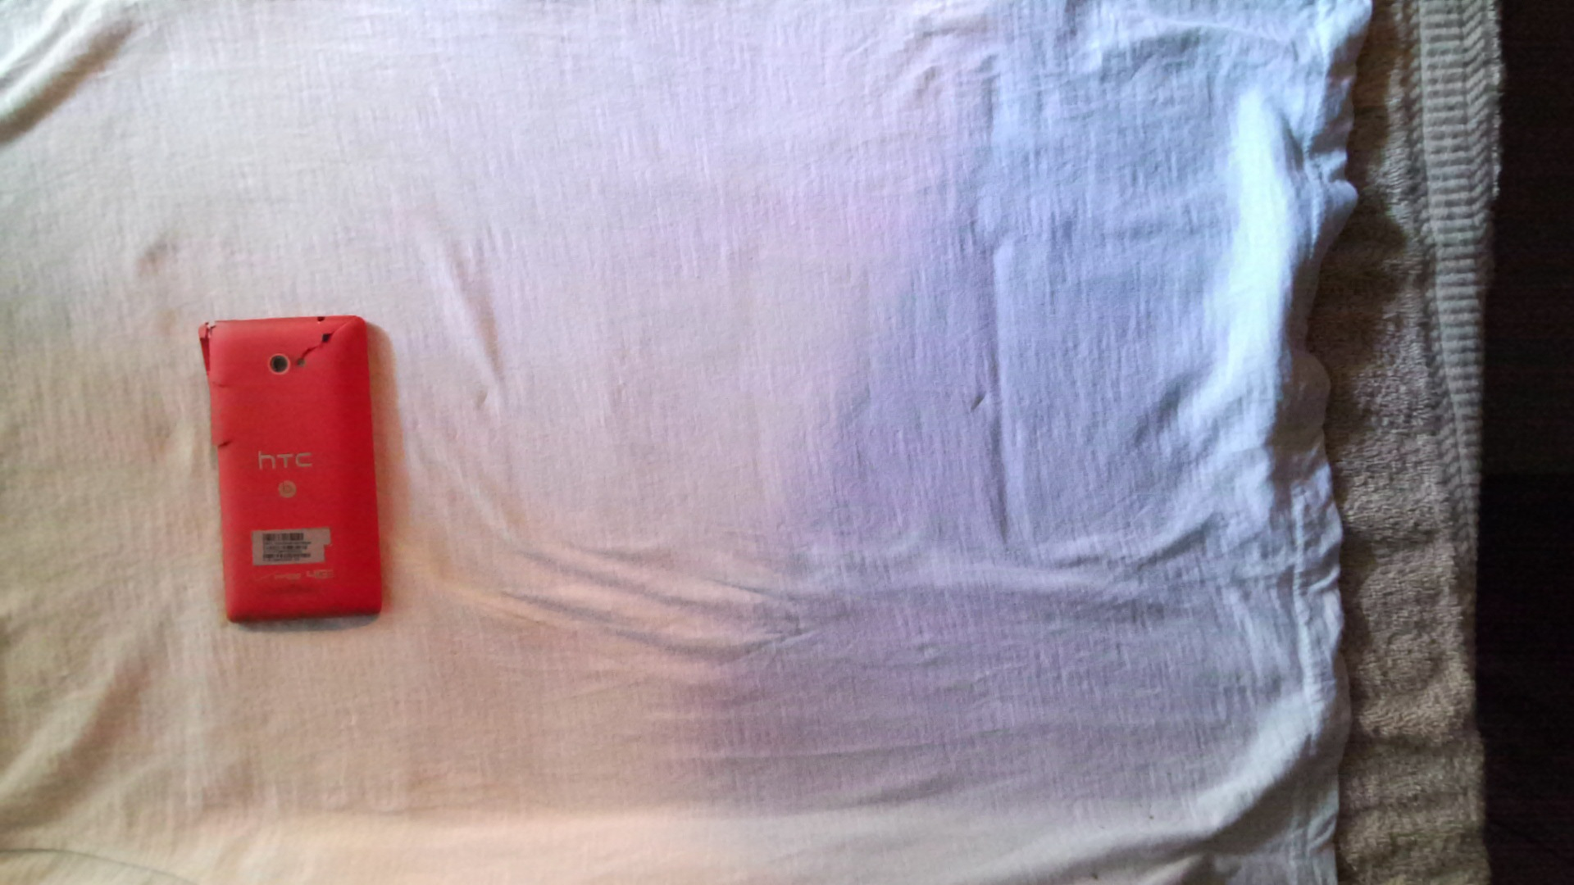
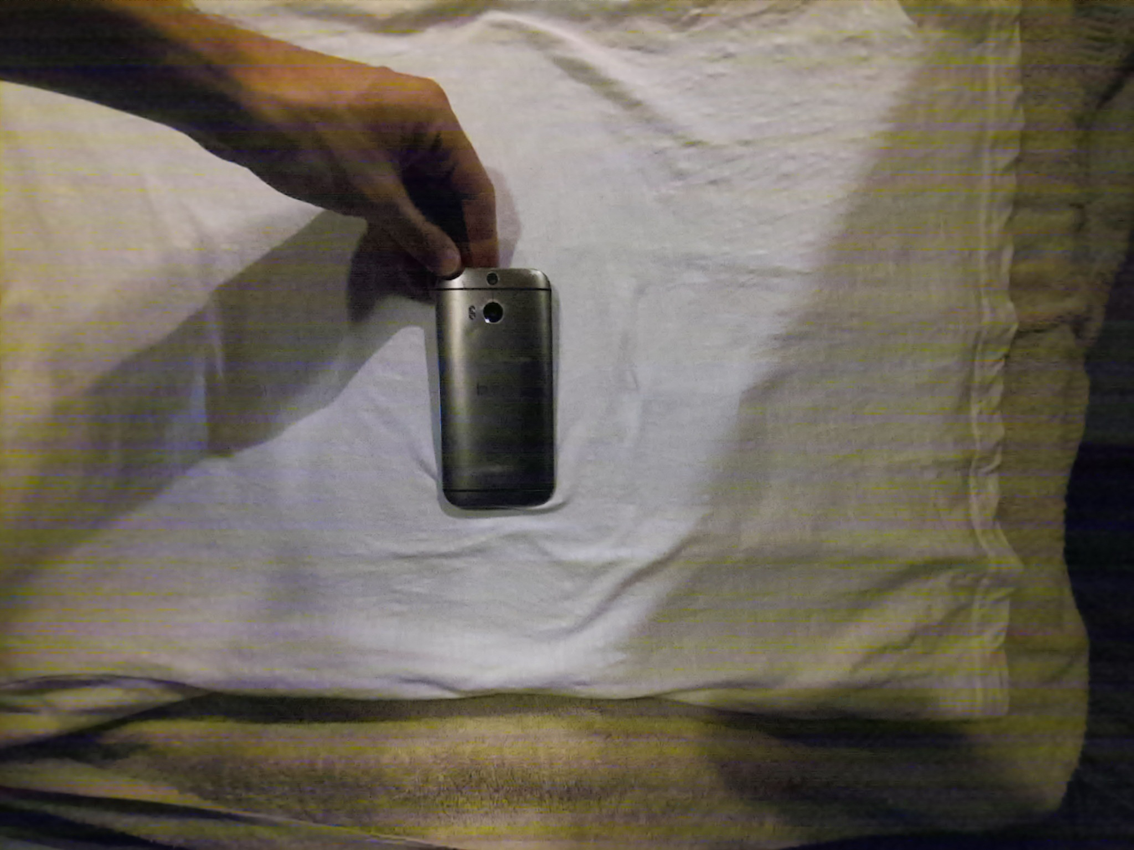
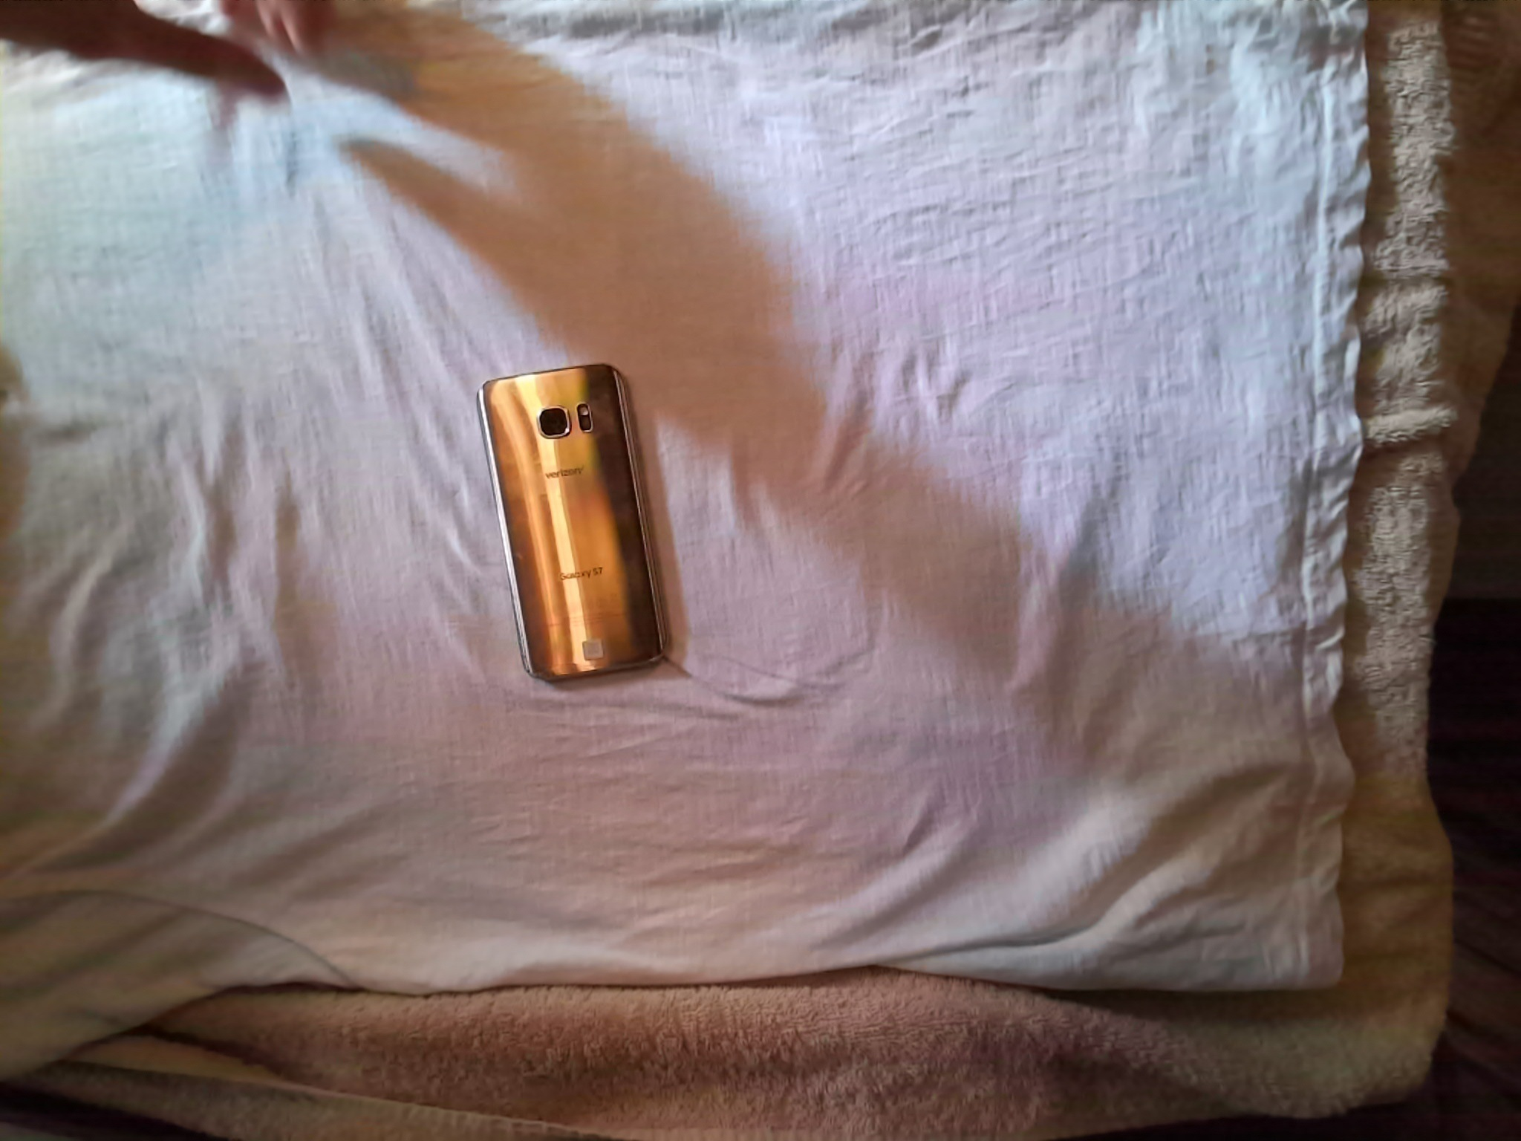
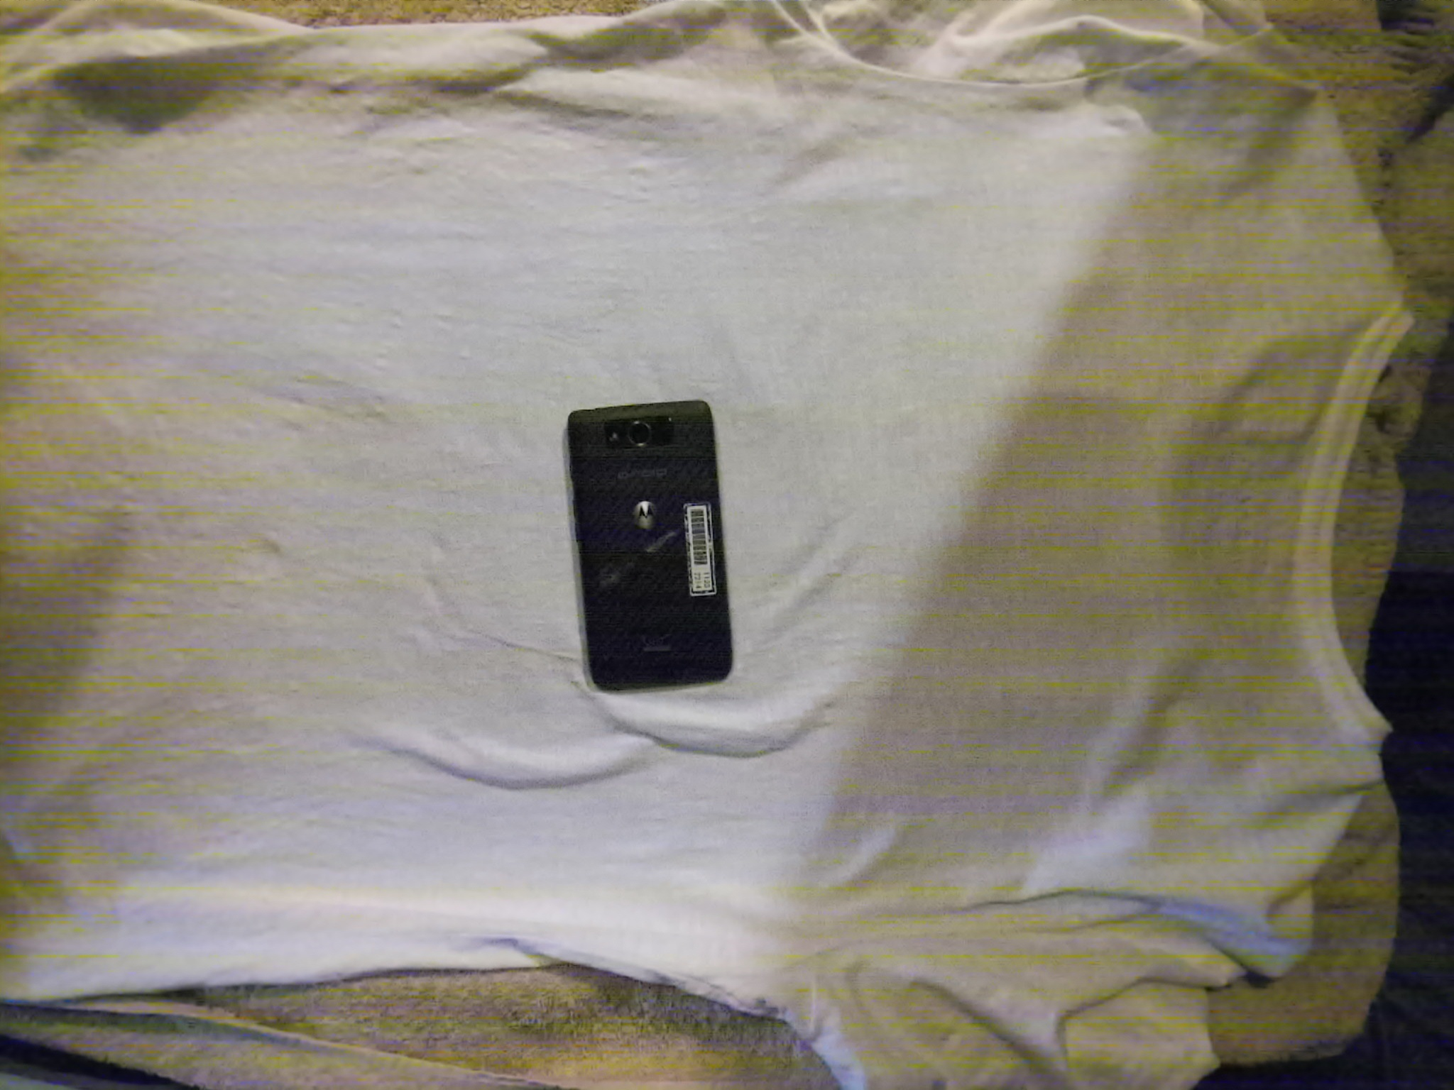
Method 2 tried this week:
Dataset
Transfer learning of classification network based on Inceptionv3 model.
Dataset:
Synthetic data generated using domain randomization
and
Single view real phone images

Slide 5
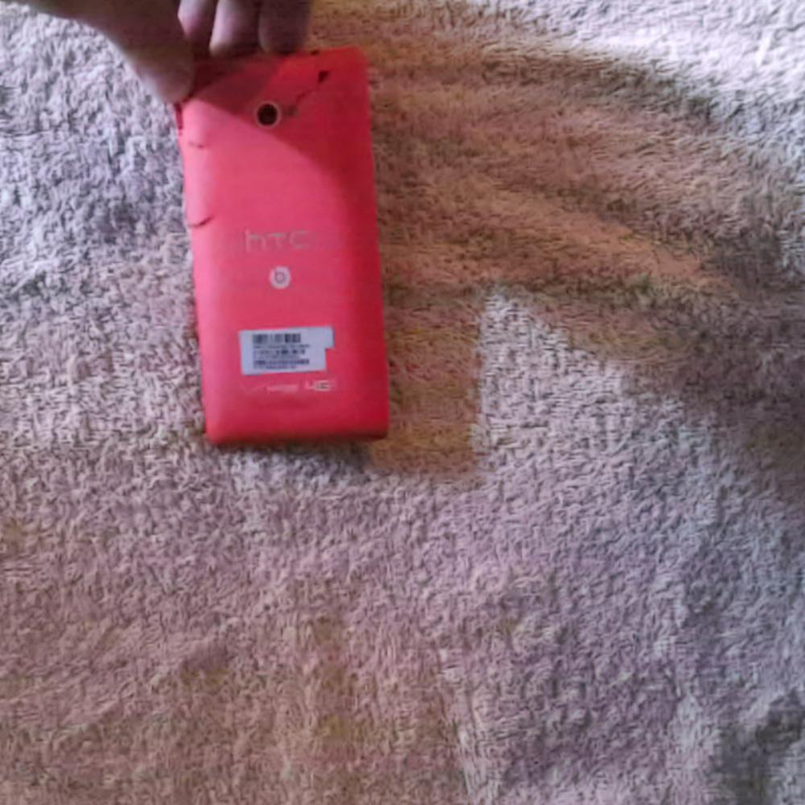
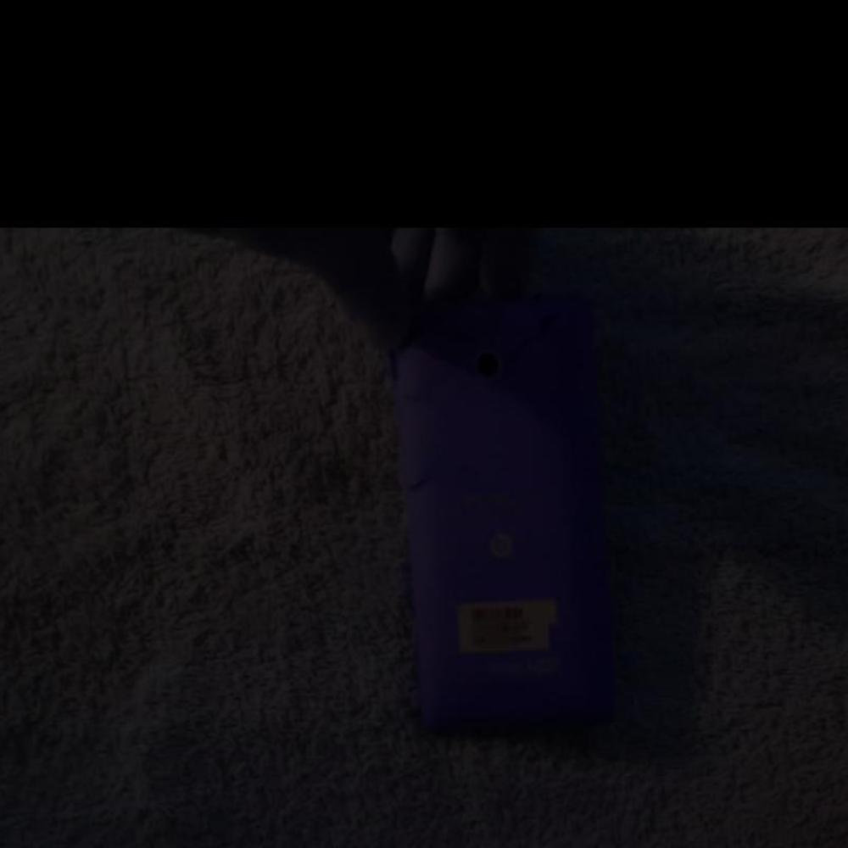
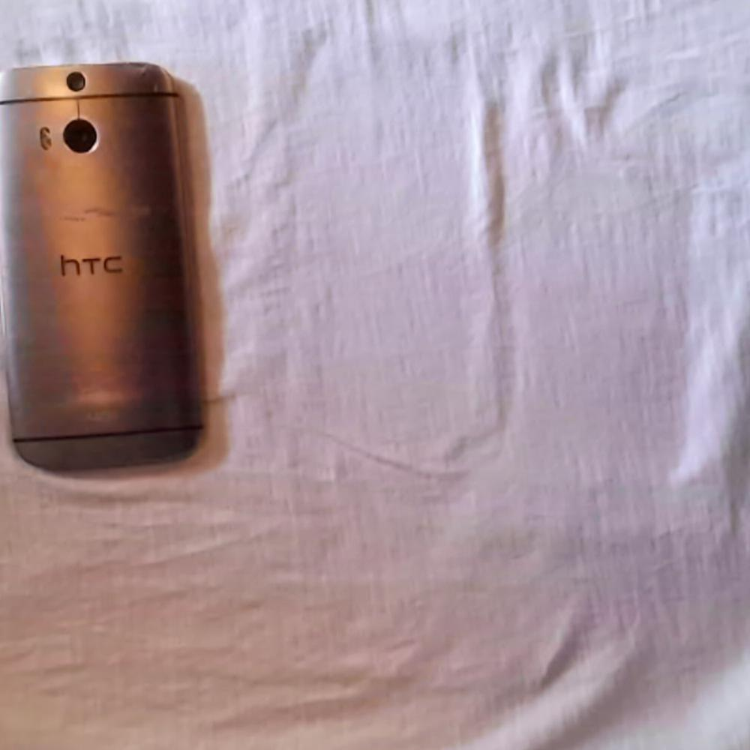
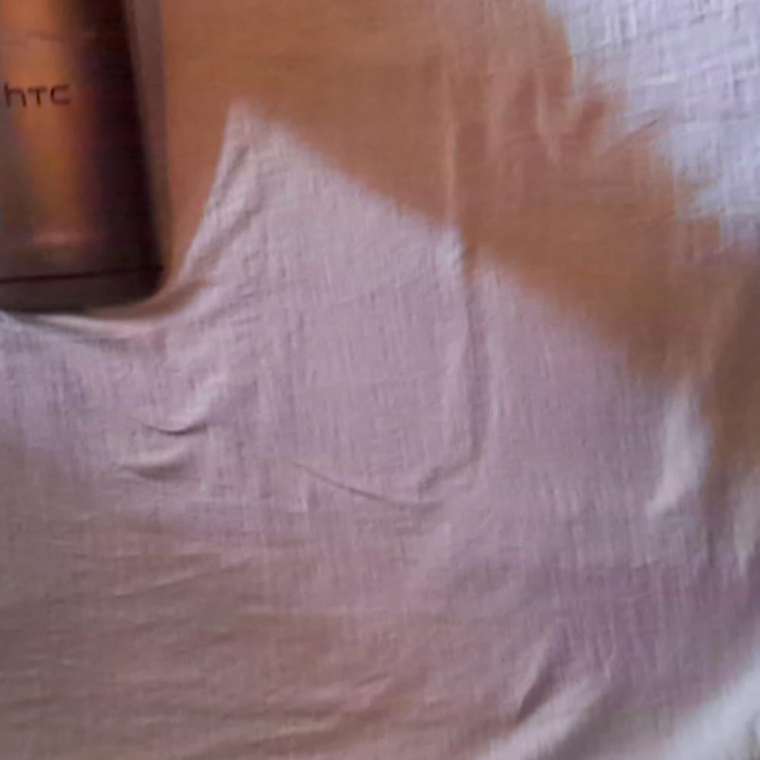
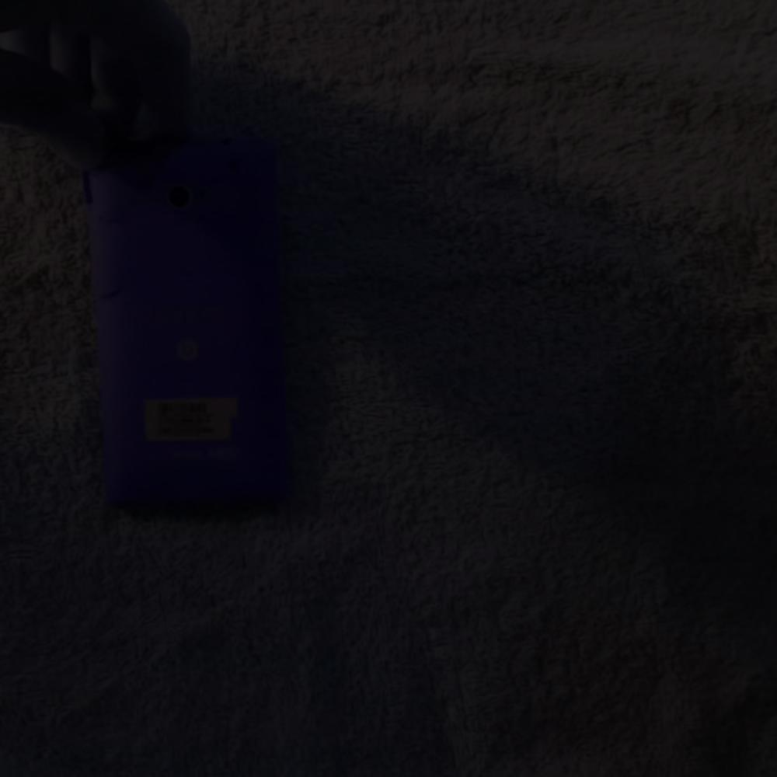
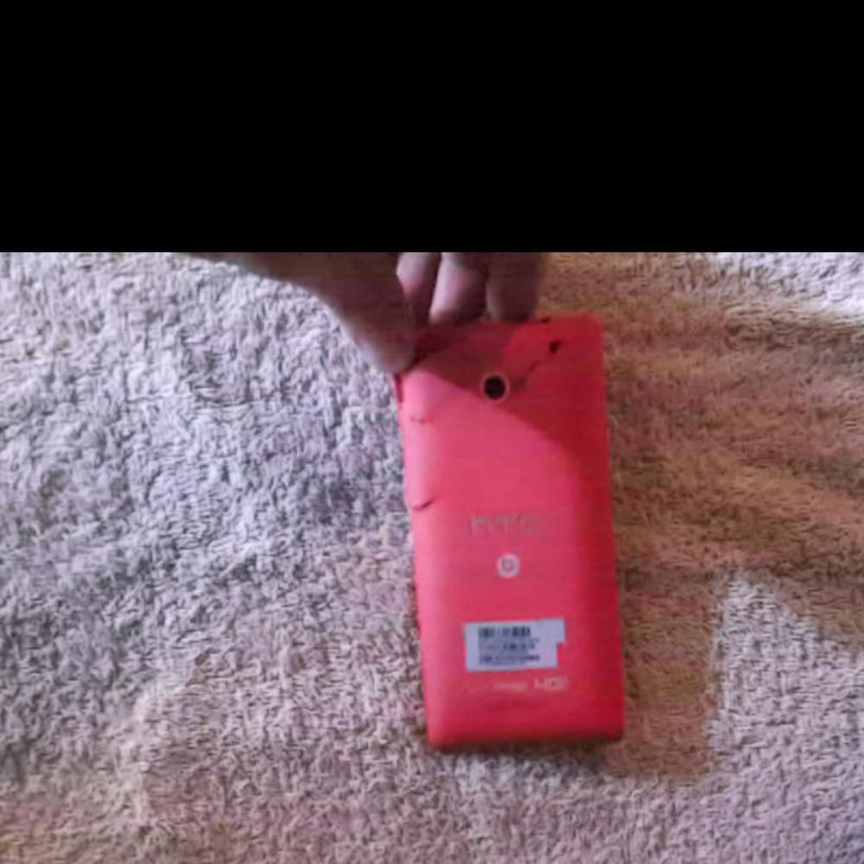
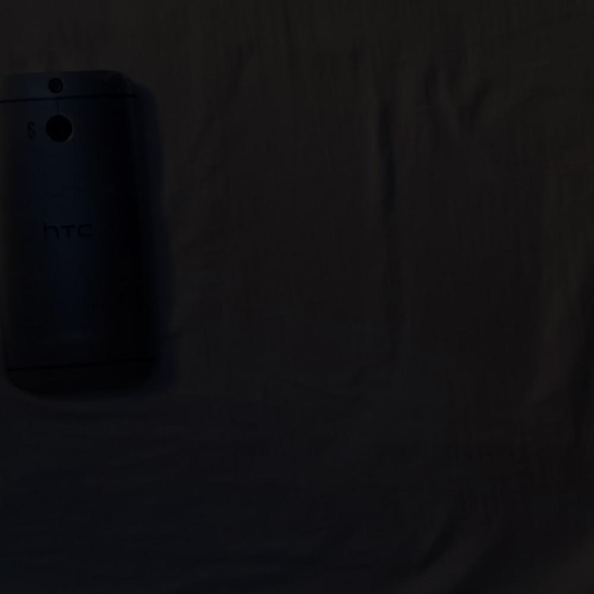
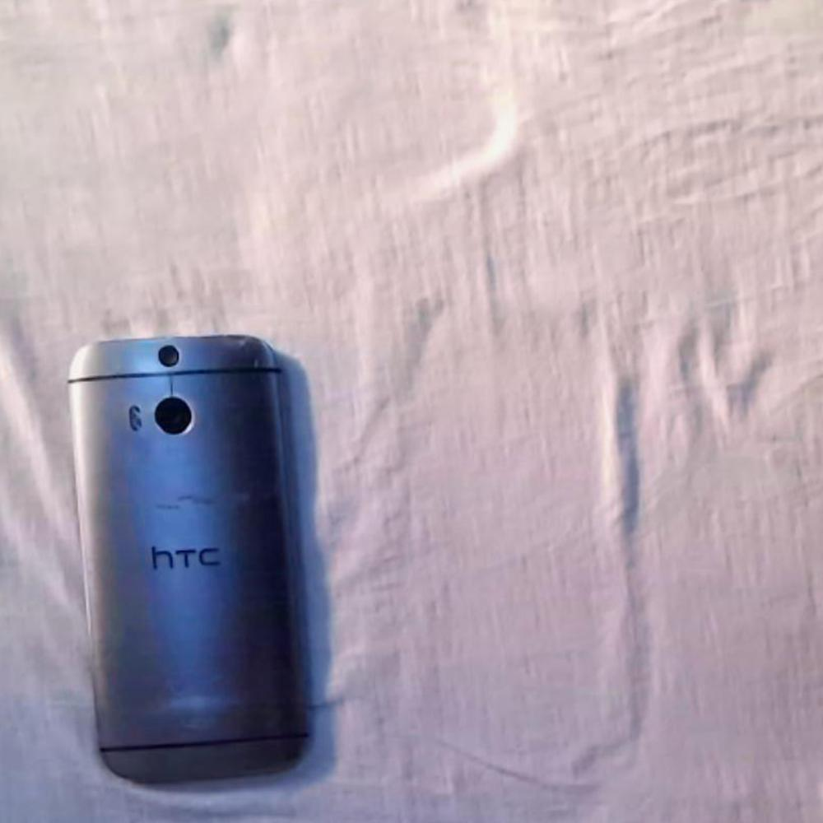
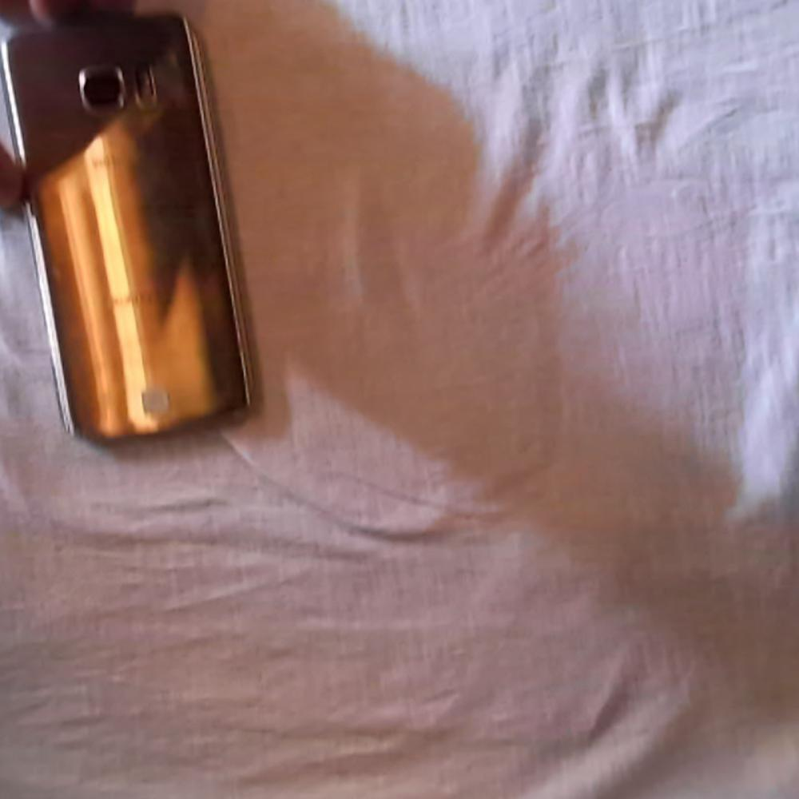
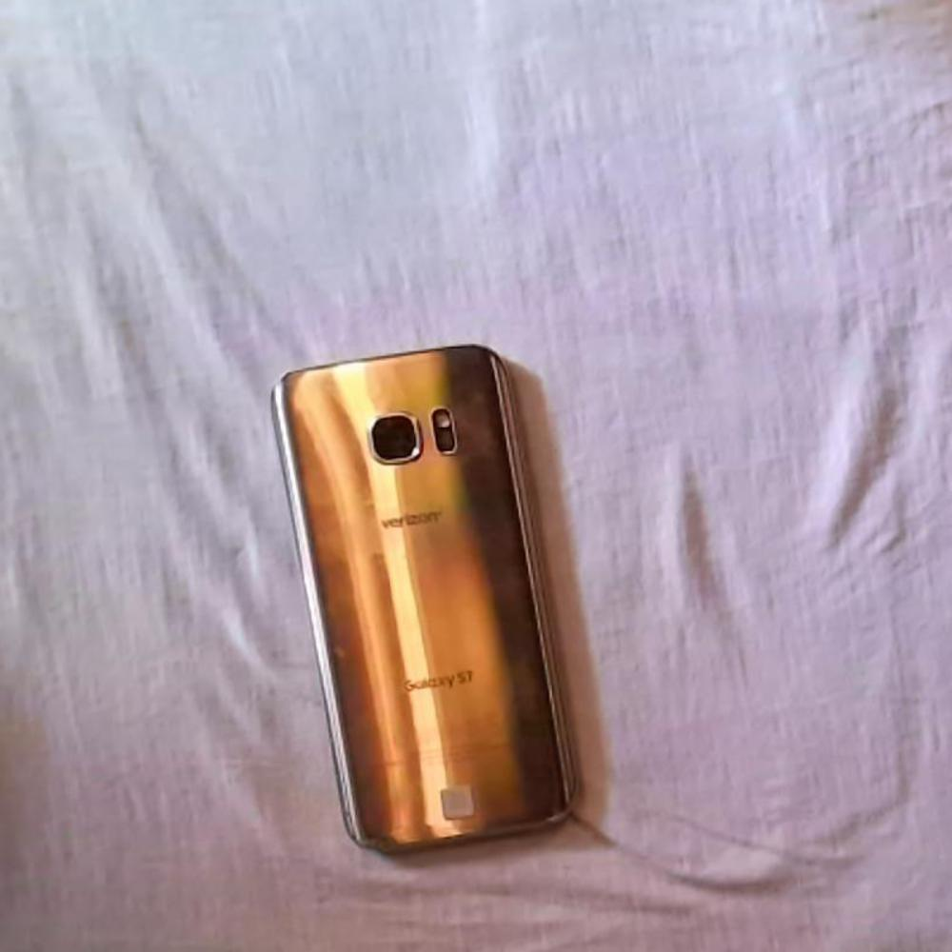
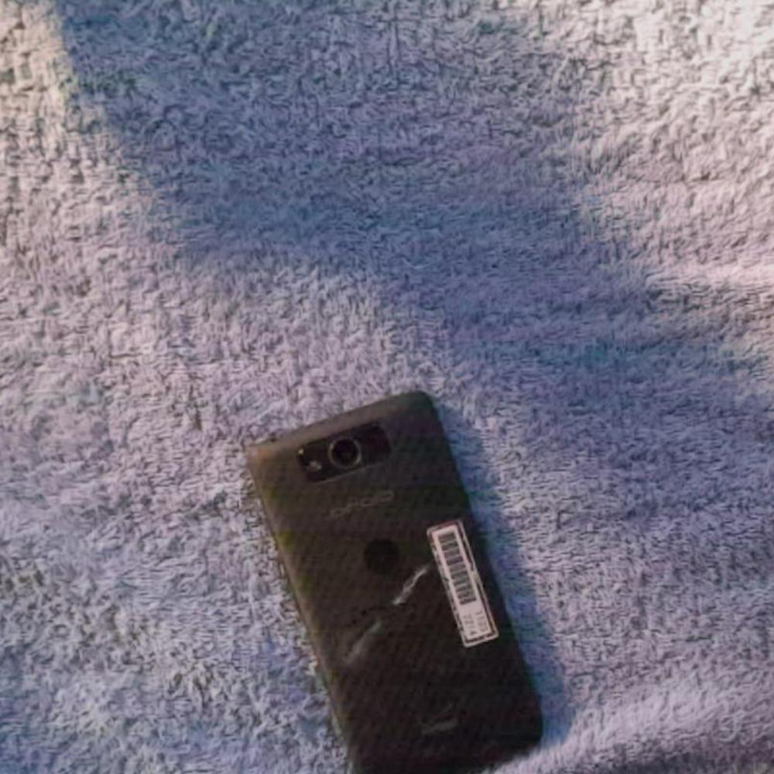
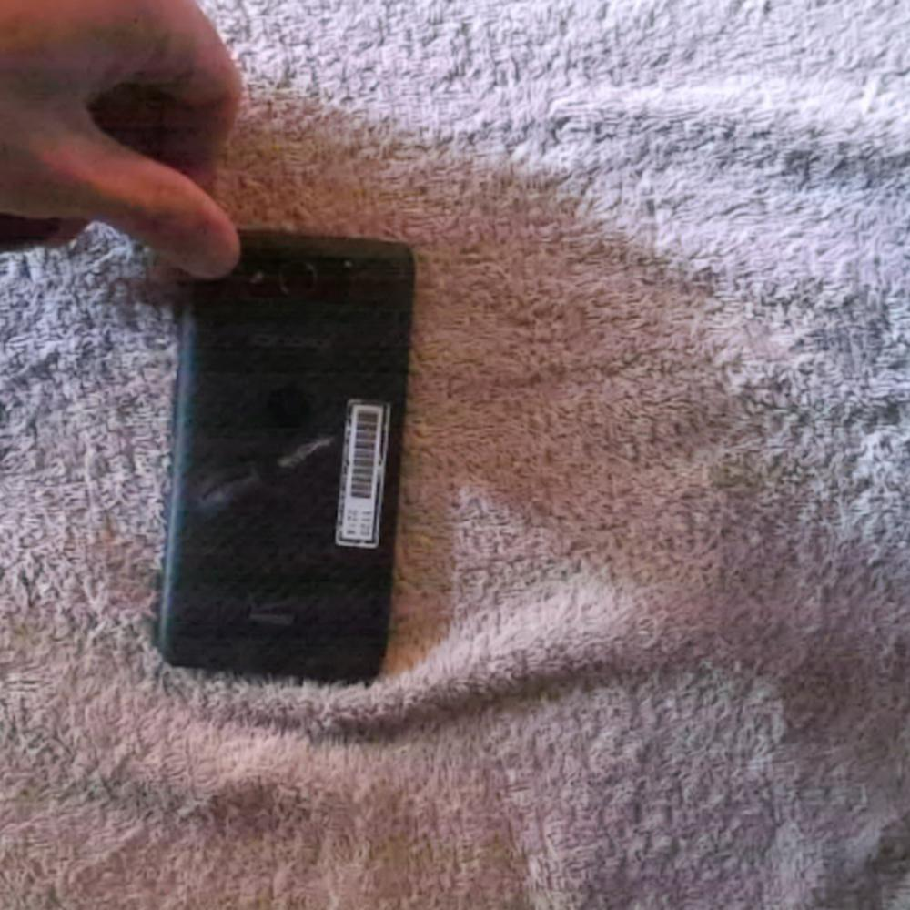
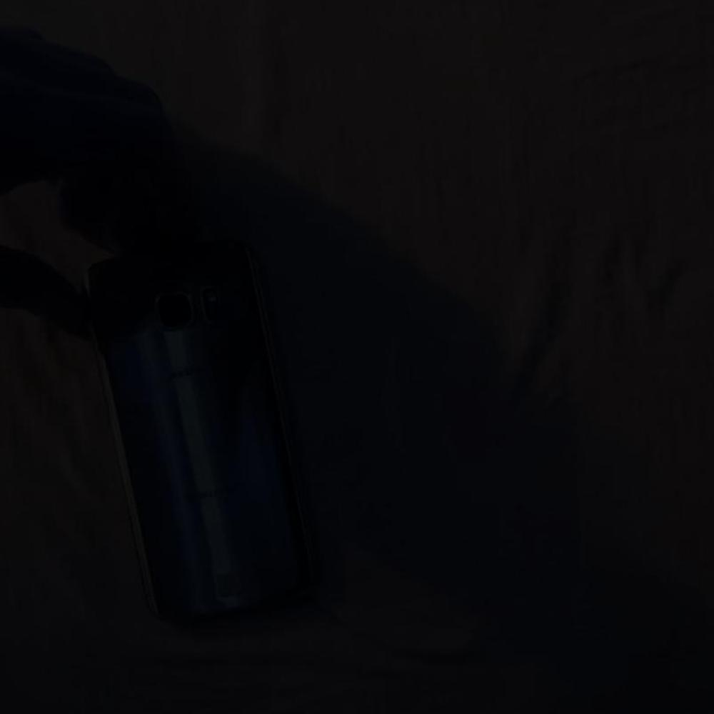
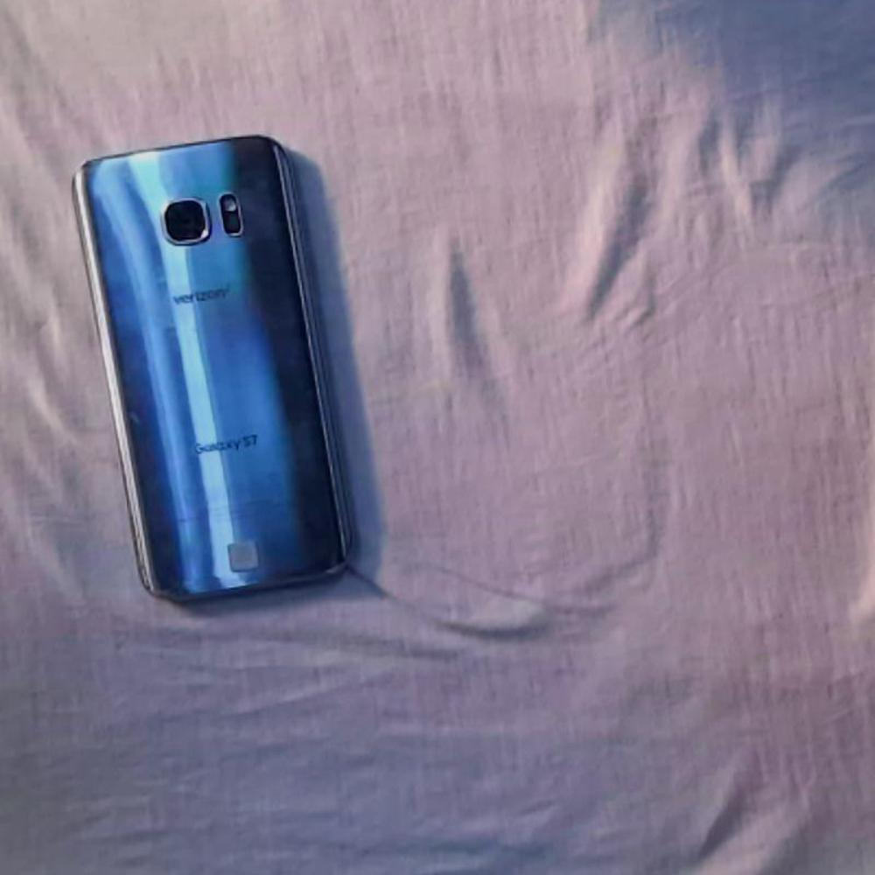
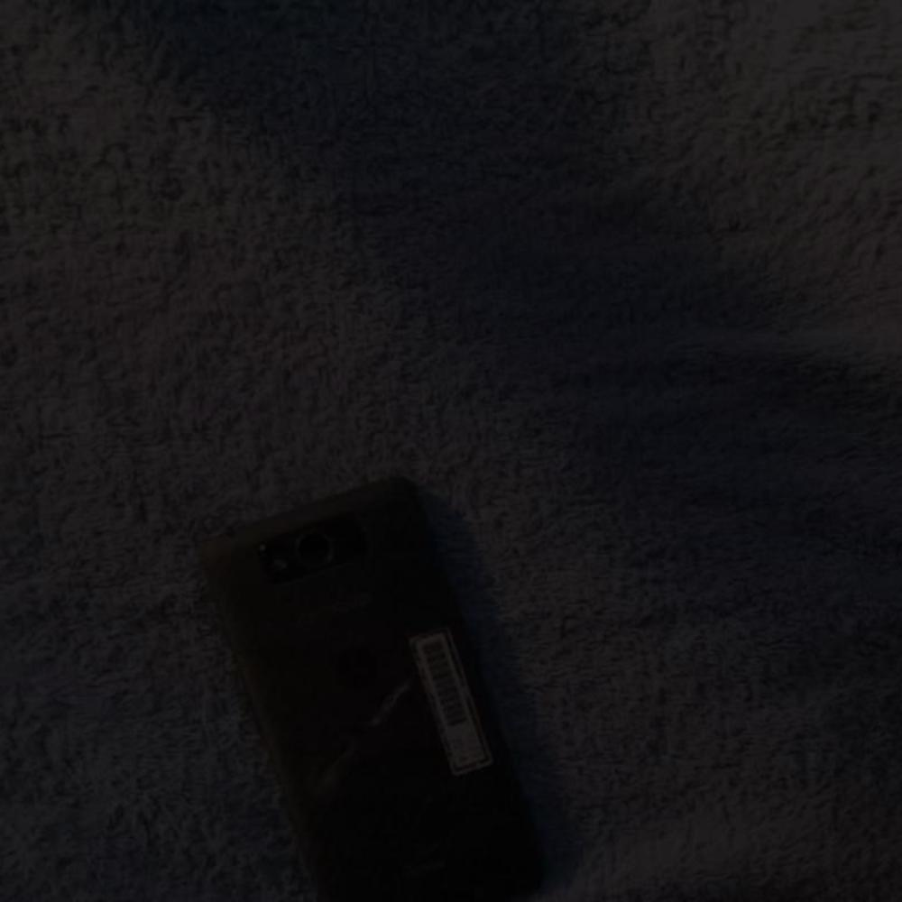
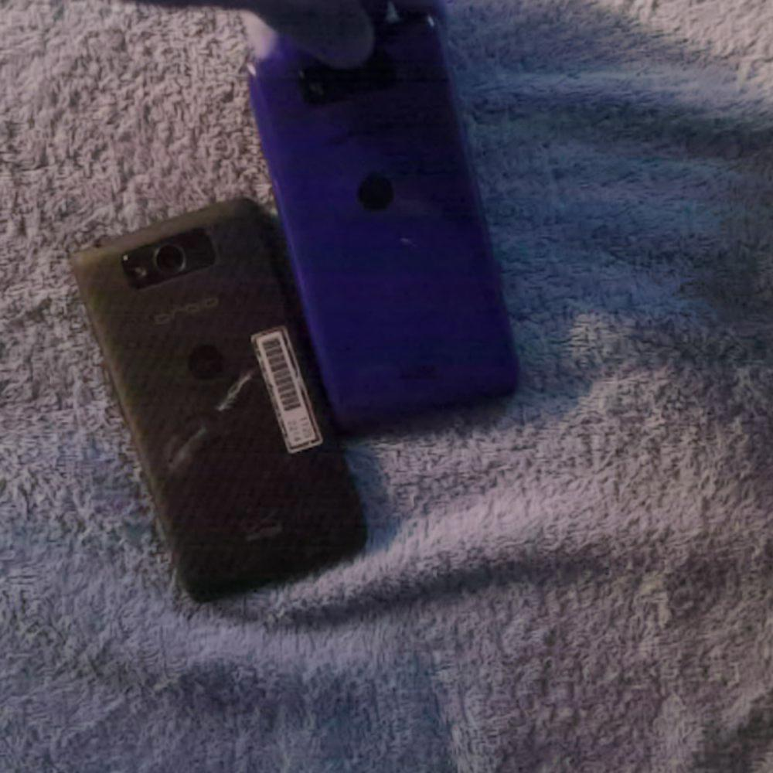
Real phone dataset generation
Augmentation techniques:
Flipping
Color Inversion
Translation
Rotation
Brightness
400 images per class

Slide 6
Accuracy results
Observations:
Exp | Size | Image count | Preprocessing | Best Results(%)
1 | 640x640 | 2400+400 | Synthetic+real images | 88.2(+-)2
2 | 640x640 | 2400+400 | Synthetic+real images(constant lr) | 83.19(+-)2
The model is invariant to lighting conditions,phone texture, background
The model is still affected by the camera distance.
This is doing single class classification

Slide 7
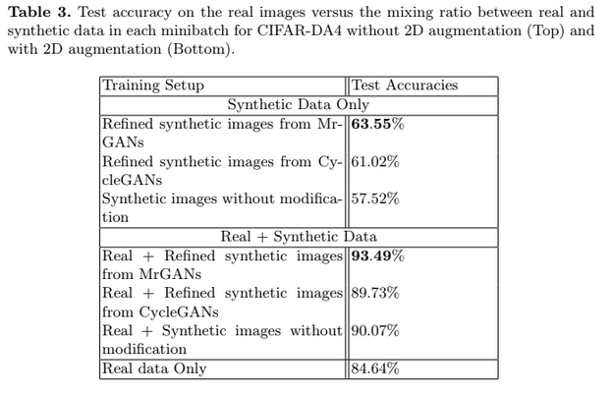
Ideas suggested in literature
This paper mentions about difference in distribution between the real and synthetic dataset.
To match the distribution, the paper suggests use of CycleGAN to match the two distributions.
Paper:Learning image classifiers from (limited) real
and (abundant) synthetic data

Slide 8
Next week’s goal
Create dataset for multi-view CNN and train model for this
Refer to paper mentioned in last slide and use cycleGAN to match distribution between the real and synthetic dataset.

